Slide 1
Understanding Ethereum Application Development
Code PaLOUsa, March 2018
Notes:
Questions welcome!

Slide 2
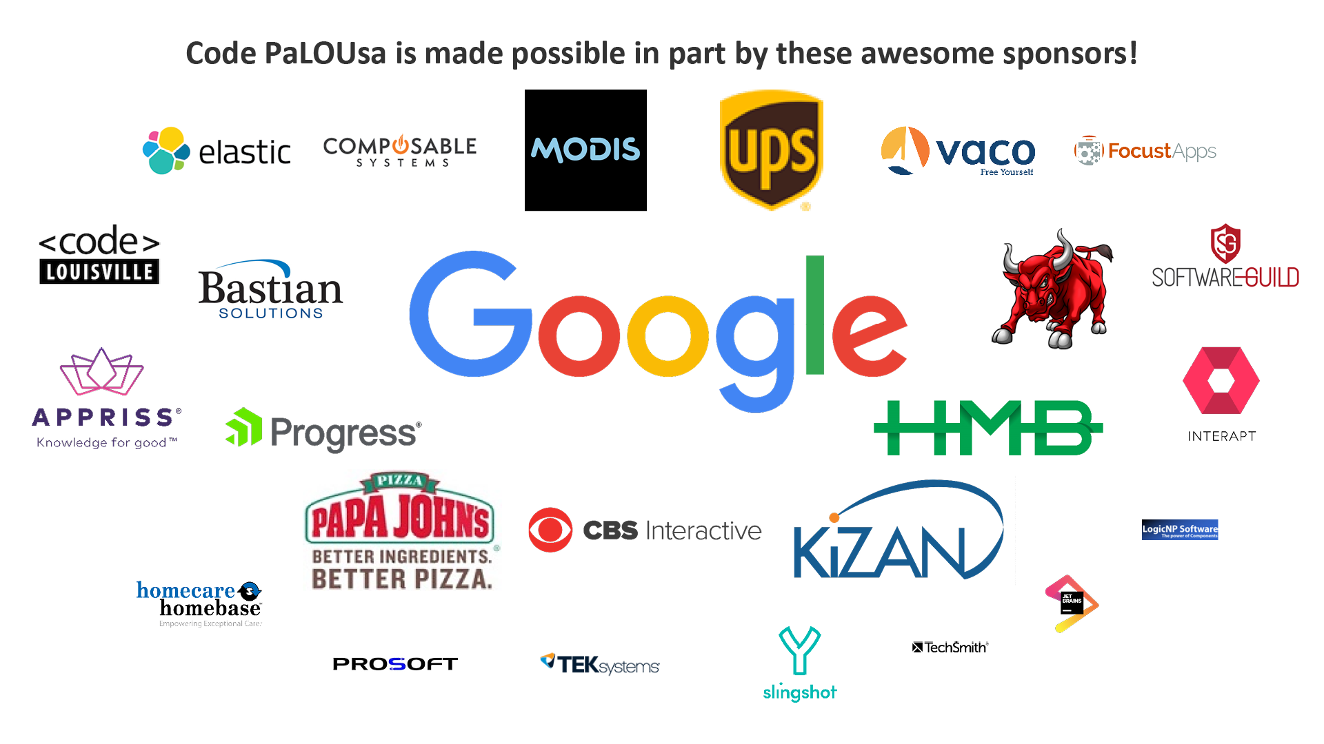

Slide 3
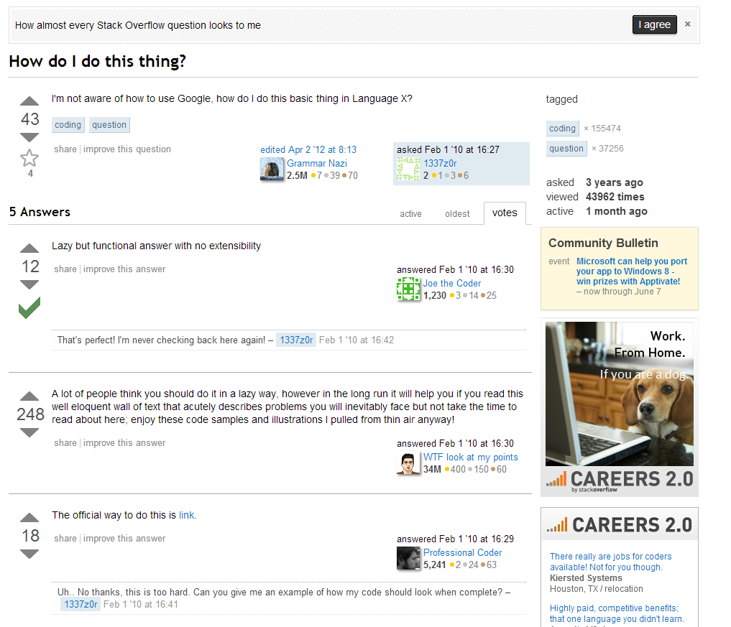
Notes:
I’m the “async guy” on Stack Overflow.
Not Jon Skeet.
Also have a blog (mostly async these days).
Regular developer, not a travel-the-world elite speaker.

Slide 4
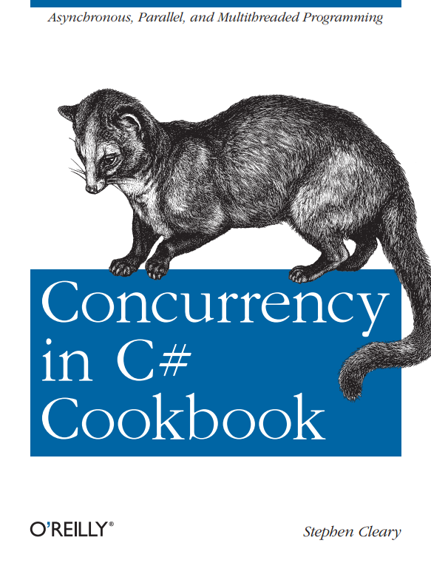

Slide 5
OK, I’m starting for reals now

Slide 6
Why Blockchain?
It’s all about trust.
Or lack of trust. ☺
Questions to keep in mind:
Who is my app trusting?
Who do my app users have to trust? (including me!)
Am I trusting my users to do what I expect? If so, how can I motivate my users?
Notes:
Trust is the theme of blockchains.
“Motivation” in this world is a form of economic force.

Slide 7
Terminology
Blockchain
Transaction Ledger
Wallet
Miner
Smart Contract
Distributed App (dApp)
Oracle
Notes:
Not: forks, etc.

Slide 8
Basic Asymmetric Cryptography
Public/Private Key Pairs
Signing and Verification
Cryptocurrency Transactions:
Public Key ~ your address
Private Key ~ your wallet

Slide 9
Blockchain Basics
Blockchain: Distributed Transaction Ledger
Transaction
Transaction
Transaction
Alice
Bob
Transaction
Transaction
Miner
Transaction
Transaction
Notes:
“Ledger”: Literally like an accounting ledger. A series of transactions.
Alice wants to send Bob some cryptocurrency. (Bob does nothing)
(click)
Alice opens her wallet (access private key), and creates and signs a transaction.
(click)
Alice submits her transaction to the pool (distributed).
(click)
A miner retrieves transactions from the pool and appends them to the blockchain.

Slide 10
Miner Motivation: Gas
Amount of gas (“limit”)
Price of gas (in Ether/Gwei)
https://ethgasstation.info/
Notes:
Miners are not altruistic lovers of blockchains. They are in it to make money.
Miners make money on transaction fees. In Ethereum, this is “gas”.
Amount of gas is always the same for cryptocurrency transfers, but can very in other cases.
Cost of gas can always vary. If you want faster transactions, raise your gas price.
Giga-wei: 1B wei. (or 1 billionth of an Ether)

Slide 11
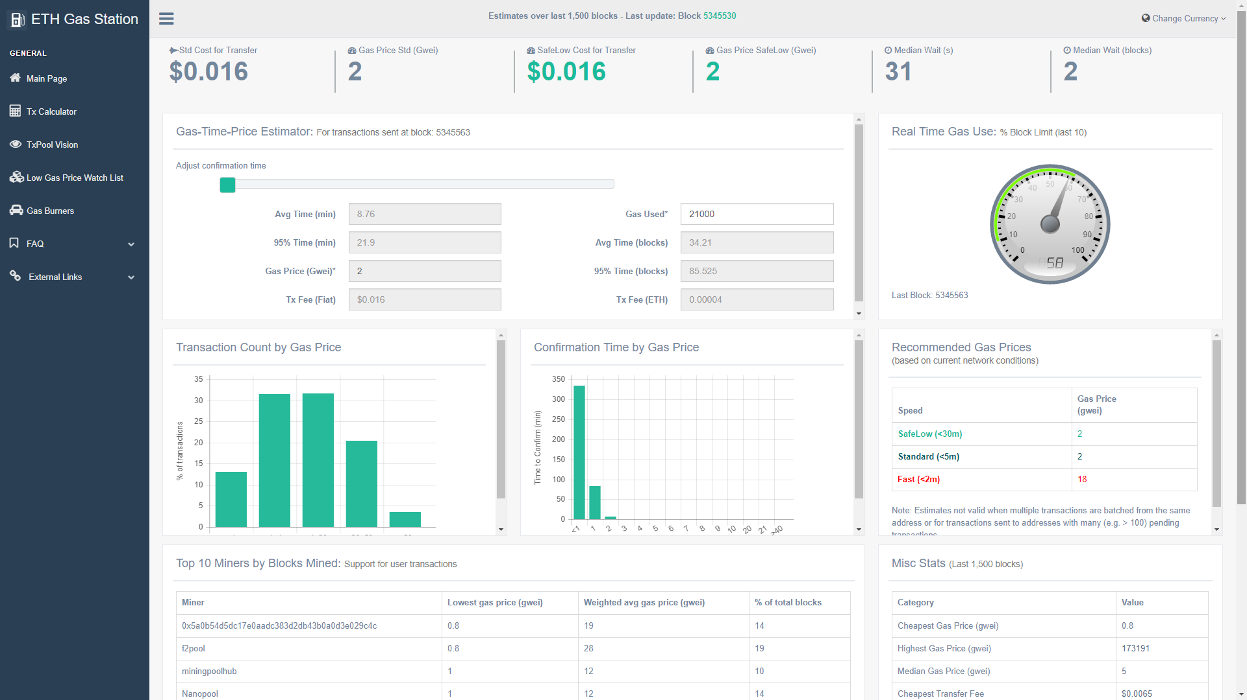
Notes:
21000 gas for a simple Ether transaction

Slide 12
Blockchain with Gas
Blockchain: Distributed Transaction Ledger
Transaction
Transaction
Transaction
Alice
Bob
Transaction
Transaction
Miner
State (balances)
Transaction
Transaction
Notes:
When Alice sends her transaction to the pool, she sets a gas limit (21k for Ether xfer) and a gas price (e.g., 2 Gwei).
Too low? Miners won’t pick it up for a while, or if the network is busy, never. Can re-submit with higher price.
Miners verify transactions, so the ledger also has a giant map/dictionary of addresses->amounts.
Let’s store other things, too! Data and code. And then transactions become method calls!

Slide 13
Blockchain with Smart Contracts
Blockchain: Distributed Transaction Ledger
Method Call
Method Call
Method Call
Alice
Bob
Method Call
Method Call
Miner
State (Code+Data)
Method Call
Method Call
Notes:
Every transaction is now a method call.
The ledger is a history of method calls (event sourcing).
State is the complete state of the blockchain, including bytecode and all data stored on the chain.
“Method call” can now include an Ether transfer, but it can also include parameter values.
This is why we have Gas: as methods execute code, they use up gas. A simple xfer is always 21k.
Note: all method calls must be deterministic, so that miners can reach consensus.

Slide 14
Smart Contract Code
Notes:
Code is trustless: by default, your users do not have to trust you, just your code.

Slide 15
Note
Solidity code defines classes.
Instances live at a specific address.

Slide 16
Solidity: Harder than it looks!
No exception handling
Easy to cause security holes
Private is not private
Notes:
It looks like JavaScript. It is NOWHERE NEAR THAT EASY!
Actually much more like embedded programming.

Slide 17
Distributed Apps (dApps)
SPA
MetaMask
Ethereum Blockchain (MetaMask)
web3
Smart Contract
Wallet
SPA
Ethereum Blockchain (self, Infura)
web3
Smart Contract
Wallet

Slide 18
Blockchain Code & Data
Benefits:
Trustless
Distributed
Immutable history
Drawbacks:
Expensive!

Slide 19
Oracles
Blockchain has perfect history
Contract code can react to its own state (deterministically)
What about outside state?
Method Call
Method Call
Method Call
Method Call
Miner
State (Code+Data)
Notes:
Oracles solve the problem of how to get “outside state” into the blockchain.
E.g., who won the SuperBowl?
Or: random numbers?
Or: what time is it?

Slide 20
Oracles
Owner
Asking users to trust you. :/
Quorum
Only harder to bribe, not impossible.
Algorithmic
Notes:
Oracles require trust, which is a problem.

Slide 21
Smart Contract Patterns

Slide 22
Owner
Special address (usually the creator) has unique privileges.
By default, the contract creator has no special power.
Owner allows Pausing.
Notes:
Trustable: developers/creators have no special privileges or power over their contracts.
Anyone can create an instance of your smart contract code. They are then the owner of that instance.
Pausing is a separate pattern. It’s a circuit breaker; when under attack, you can pause until you figure it out.

Slide 23
Upgradeable
Delegate from proxy contract to implementation contract
See also: truffle migrate
Notes:
Trustable: means immutable. For a given address, the contract code deployed there can never change.

Slide 24
Code Patterns
Withdraw
Explicit withdraw method. Pull, not push.
Checks-Effects-Interactions
Save all state changes before invoking any untrusted code.
Cooldown
Prevent miner interference with forced waits.
Notes:
Miners can:
Reorder transactions (thus causing one to fail, increasing their fees).
Inject transactions (this is why most betting-style contracts have a “lock” period).

Slide 25
Getting Started with Solidity
Official Solidity docs: https://solidity.readthedocs.io/en/develop/
CryptoZombies: https://cryptozombies.io/
Zeppelin guides: https://blog.zeppelin.solutions/guides/home
https://github.com/ConsenSys/smart-contract-best-practices

Slide 26

Q&A
Go forth and be awesome!
Image from Etsy user Rosewine; used with permission
Notes:
Slides are available at StephenCleary.com

